Slide 1
Wind Energy

Slide 2
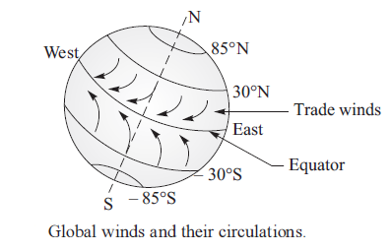
Origin of Winds
Global Winds
Local Winds

Slide 3
Global and Local Winds
The primary force for global winds is produced due to differential heating of the earth surface at equator (0° longitudes) and polar regions (about ± 90° longitude). More heating takes place near the regions of equator and less heating occurs at polar regions, and so cold winds move from polar to equatorial regions. The air in touch with ocean water is much colder than air in the plain areas, and so cold winds generated from ocean areas move towards plain areas.
The rotation of the earth on its axis produces Coriolis force and this force is responsible for forcing the global winds towards westernly direction. These air currents are also called trade winds as sailing ships in the past used these air currents for ship movement and trading. The global winds and circulations are shown in Figure.
Local winds are generated due to uneven heating. Uneven heating occurs on land surface and water bodies due to solar radiation. As a result, cool and heavy air currents move from water bodies to land surface. At night, the direction of wind is reversed as land surface cools more rapidly than water bodies. The same conditions also prevail in hilly areas where hill slope heats up during the day and cools down during the night more rapidly than the low land. This temperature difference causes air currents to move to the hill slope during the day and to the low-lying land during night.

Slide 4
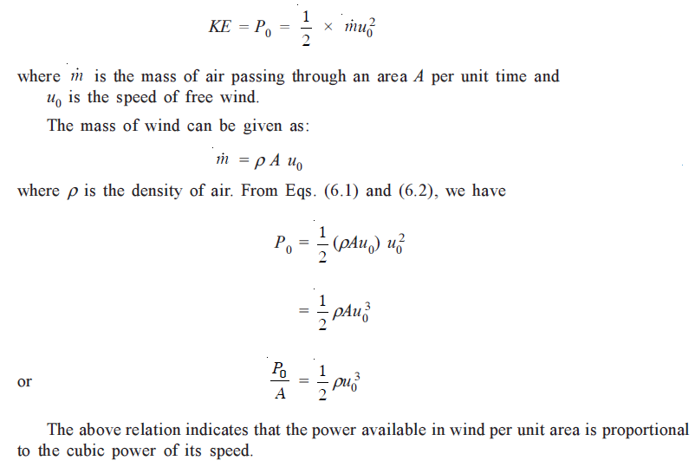
Energy Available in Wind

Slide 5
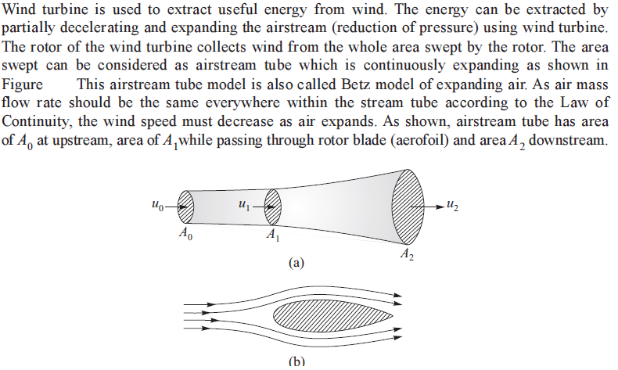
Principle of Power generation

Slide 6
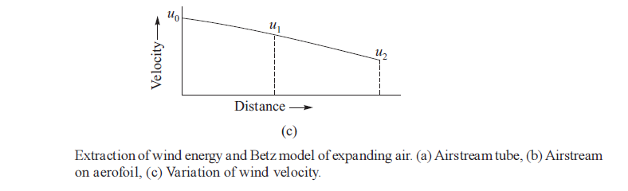
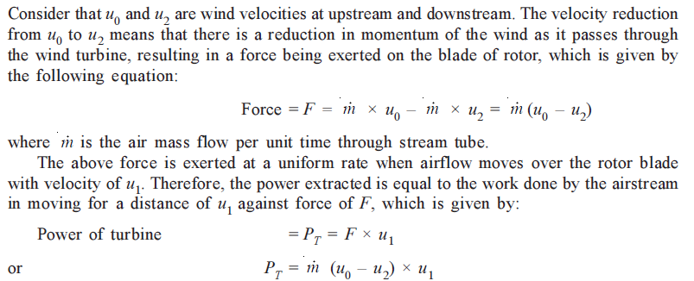
Contd…

Slide 7
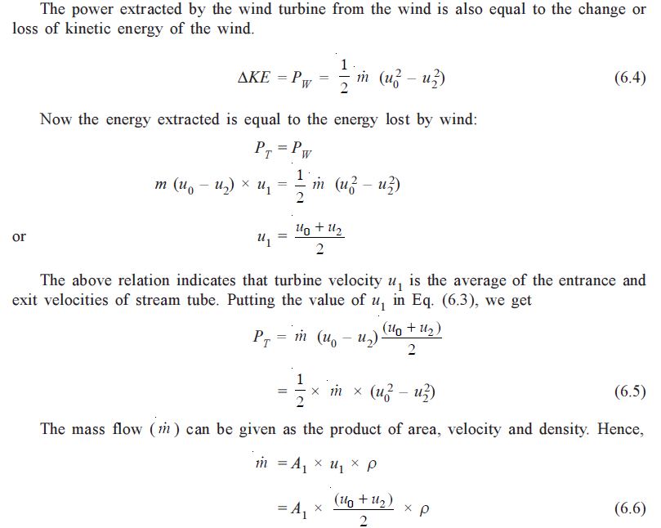
Contd…

Slide 8
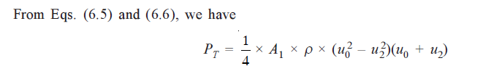
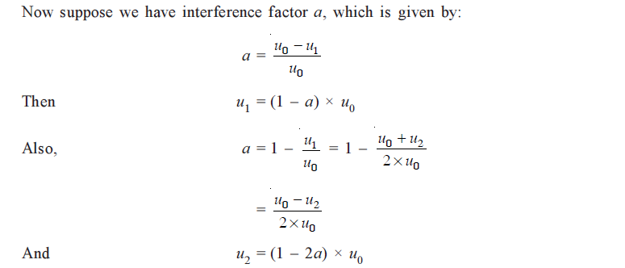
Contd…

Slide 9
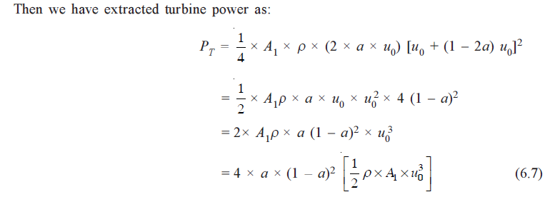
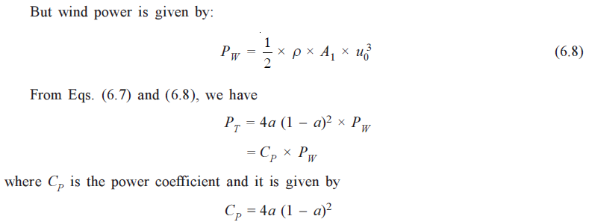
Contd…

Slide 10
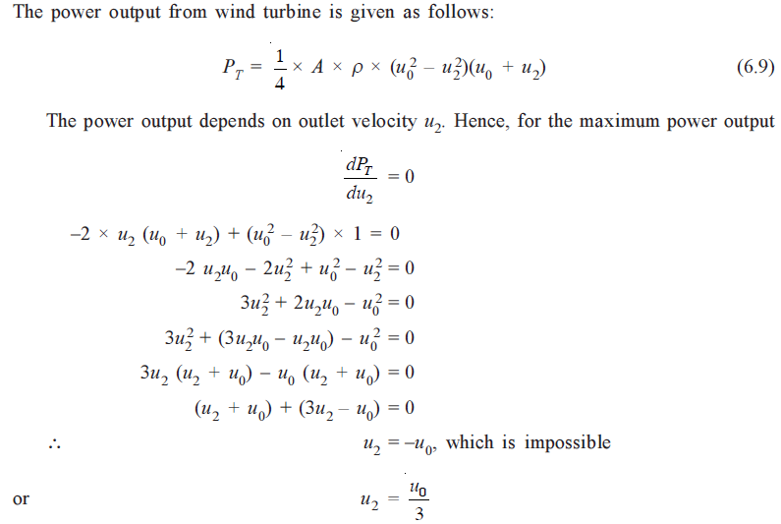
Maximum Power

Slide 11
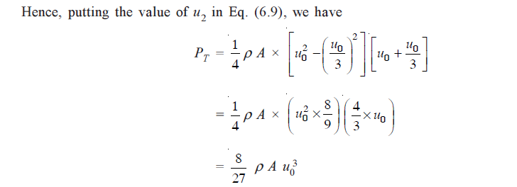
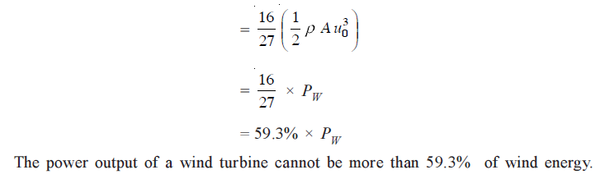
Contd…

Slide 12
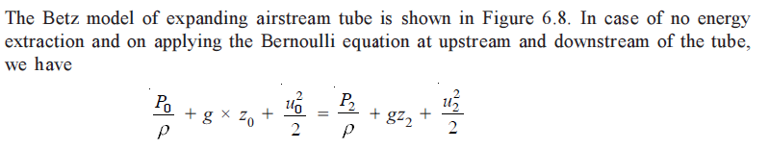
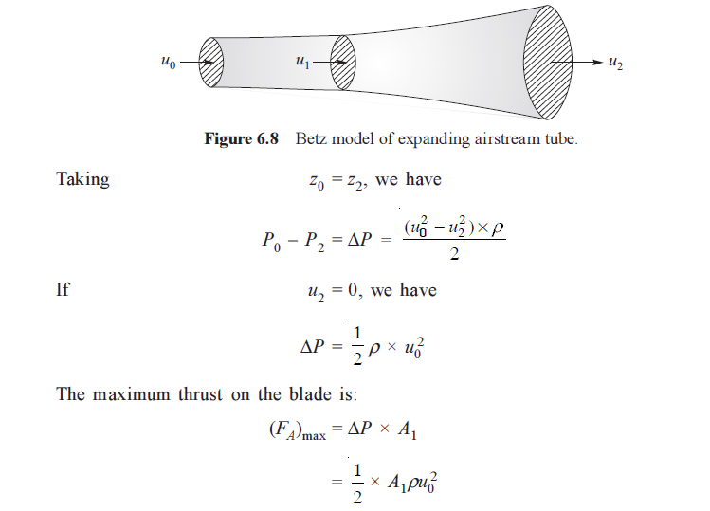
Axial Thrust on Turbine

Slide 13
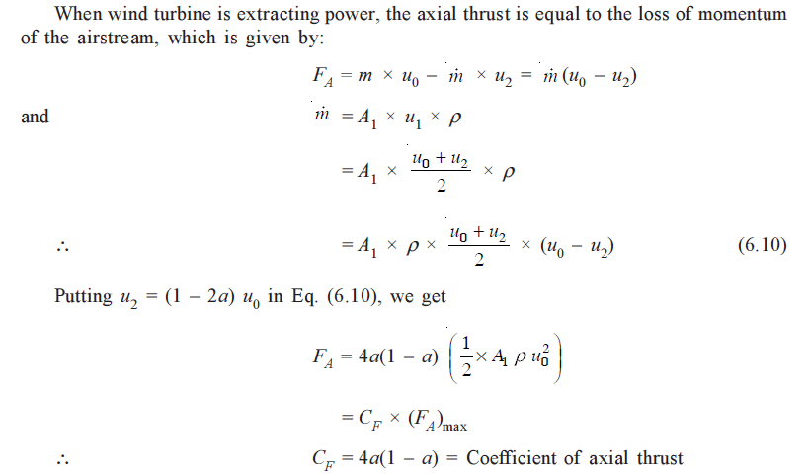

Contd…

Slide 14
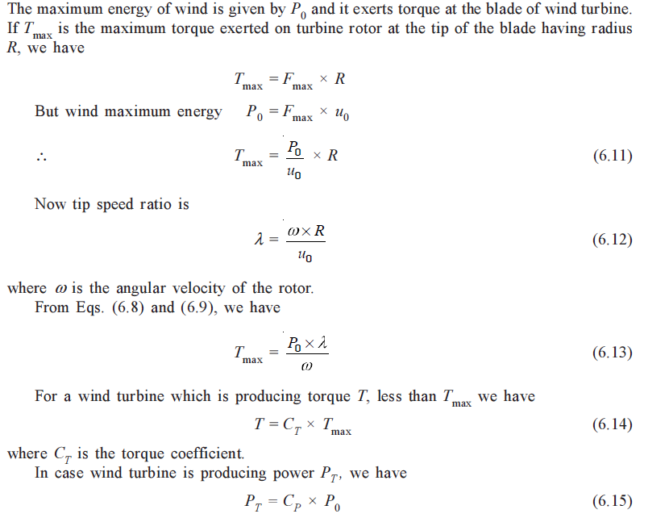
Torque generated by Wind Turbine

Slide 15
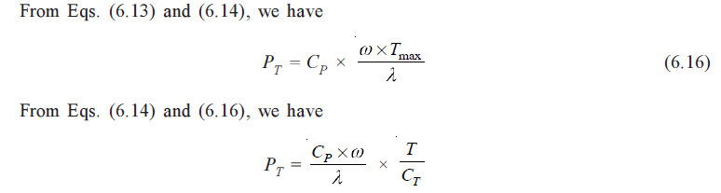
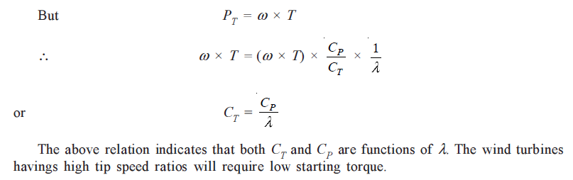
Torque generated by Wind Turbine

Slide 16
Lift & Drag: Basis for WEC
Lift forces act perpendicular to the air flow while the drag force act in the direction of air flow.
Lift forces are produced by changing the velocity of the air stream over either side of the lifting surfaces speeding up the air flow causes the pressure to drop, while slowing the air stream down leads to increase in pressure. In other words, any change in velocity generates a pressure difference across the lifting surface. This pressure difference produces a force that begins to act on the high pressure side and moves towards the low pressure side of the lifting surface which is called an aero foil.
A good aero foil has a high lift/drag ratio.
The lift increases as the angle formed at the junction of the aero foil and the air stream( the angle of attack) becomes less and less acute, up to the point where the angle of air flow on the low pressure side becomes excessive. When this happens , the air flow breaks away from the low pressure side. A lot of turbulence ensues, the lift decrease and the drag increases quite substantially, this phenomenon is called as Stalling.
For efficient operation, a wind turbine blade needs to function with as much lift and as little drag as possible because drag dissipates energy.

Slide 17
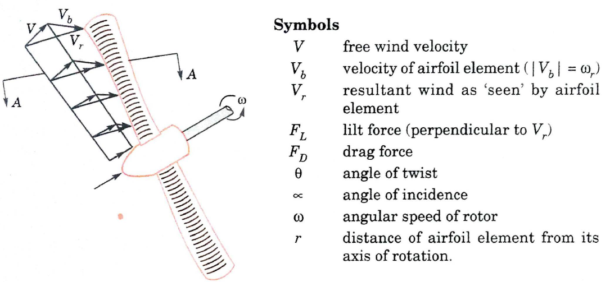
Lift & Drag

Slide 18
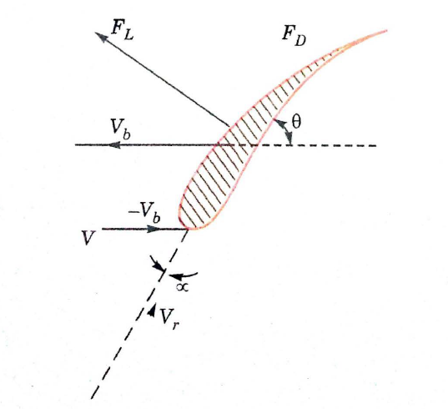
Lift & Drag

Slide 19
Site Selection Considerations
The power available in the wind increases rapidly with the speed, hence wind energy conversion machines should be located preferable in areas where the winds are strong and persistent.
Some of the main considerations are discussed below
High annual average wind speed: P= KV3
Availability of anemometry data.
Availability of wind velocity curve at the proposed site.
Wind structure at the proposed site.
Altitude of the proposed site.
Distance to Roads or Railways.
Nearness of site to local centre.
Nature of ground.
Favorable land cost.

Slide 20
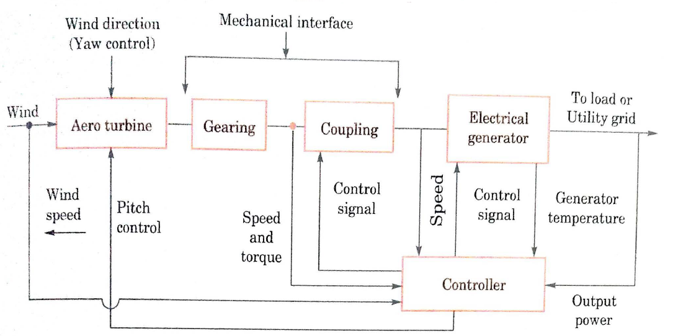
Basic Components of WECS

Slide 21
Basic Components of WECS
Aero-turbine convert energy in moving air to rotary mechanical energy. In general they require pitch control and yaw control(only in the case of HAWT) for proper operation.
A mechanical interface consisting of a step up gear and a suitable coupling transmits the rotary mechanical energy to an electrical generator.
The output of this generator is connected to the load or power grid as the application warrants.
Yaw Control: For localities with the prevailing wind in one direction, the design of the turbine is greatly simplified. The rotor can be in a fixed orientation with the swept area perpendicular to the predominant wind direction. Such a machine is said to be yaw fixed. Most wind turbines, as the wind direction changes, a motor rotates the turbine slowly about the vertical axis so as to face the blades into the wind. The area of wind stream swept by the wind rotor is then a maximum. In small turbines, yaw action is controlled by a tail vane. In large machines, a servo mechanism operated by a wind direction sensor controls the yaw motor that keeps the turbine properly oriented.
The purpose of the controller is to sense the wind speed, wind direction, shaft speed and torques at one or more points, output power and generator temperature as necessary and appropriate control signals for matching the electrical output to the wind energy input and protect the system from extreme conditions brought upon by strong winds electrical faults, and the like

Slide 22
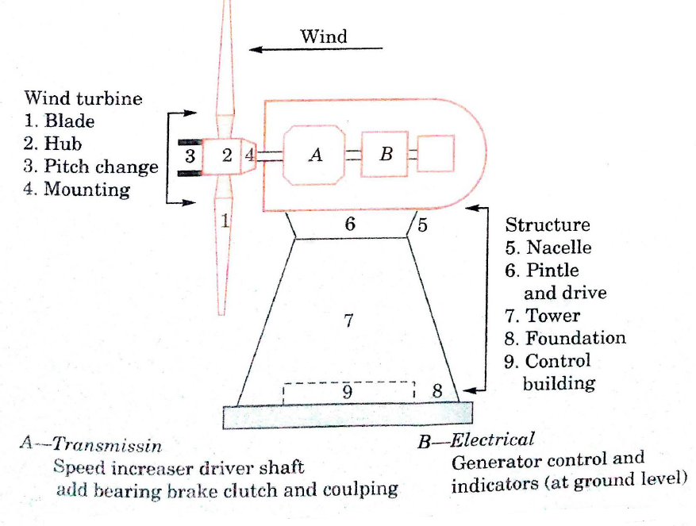
Aero-generator

Slide 23
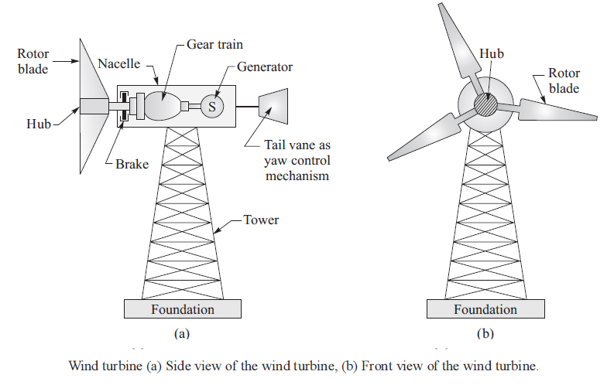
HAWT

Slide 24
HAWT
The constructional details of a three-bladed, horizontal axis wind turbine are shown in Figure. The components or main subsystems include turbine blades, hub, nacelle, yaw control mechanism, generator and tower.
Turbine blades
Turbine blades have aero-foil type cross section to extract energy from wind. These blades are made of high-density materials such as wood, glass fiber and epoxy composites. The blades are twisted from tip to root to maintain pitch angle. Most of wind turbines have two- or three- blades similar to the propeller of an old aero-plane, but blades of a wind turbine rotates very slowly compared to that of an aero-plane. A two-bladed rotors give much smoother power output compared to three-bladed rotors. A three-bladed rotor generates little more power output (more than 5%), but additional blade incorporation adds to substantial additional weight to the windmill (about 50% extra). A two-bladed rotor is also simpler to be constructed and erected on the ground.
Hub
The central solid portion of a rotor is called hub. It helps in the attachment of all blades and the incorporation of pitch angle control mechanism.

Slide 25
HAWT
Nacelle
The rotor is attached to nacelle which is mounted at the top of a tower. It houses gearbox, generator, controls and brakes. The purpose of gearbox is to regulate the output rotation from the rotor with the speed of the generator. Electromagnetic brakes are provided for automatic application of brakes if the wind speeds exceed the designed speed.
Yaw control system
The yaw control system is provided to adjust the nacelle around the vertical axis so that rotor blades are always facing the wind stream. In small wind turbine, a tail vane is used as passive yaw control.
Tower
Tower is provided to support nacelle and rotor. The tower height should be sufficient so that enough wind speed can be intercepted by the rotor. For medium- and large-sized wind turbines, the tower is slightly taller than the rotor diameter, while in small sized wind turbines, the tower is much larger than the rotor diameter. There should not be any obstruction in the way of windstream in its approach to the rotor. Tower can be made of materials such as steel or concrete.
Electrical systems
The wind turbines are provided with induction generators to convert mechanical energy into electrical energy. Induction generation has brushless and rugged construction. It is also available at economical cost.

Slide 26
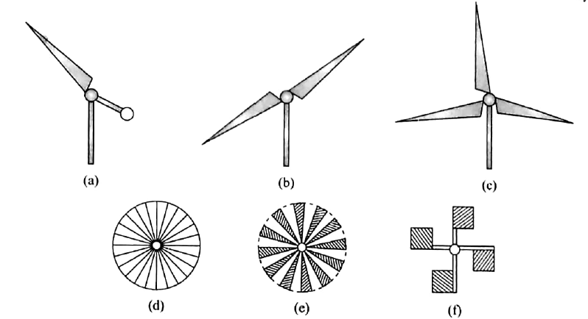

Rotors of HAWT

Slide 27
Rotors of HAWT
The rotors of HAWT can be (i) single blade rotor, (ii) two blades rotors, (iii) three blades rotors, (iv) Chalk multi blades rotor, (v) multibladed rotor and (vi) Dutch-type rotor as shown in Figure. The single, two-bladed, three-bladed and chalk multibladed rotors are relatively high-speed machines and these machines are, therefore, suitable for applications such as electric power generation. HAWTs are commonly produced with two- and three-bladed rotors. A single-bladed rotor with balancing counterweight has simple construction and less cost, but it makes more noise during operation. It is used where small power is required. The multibladed and Dutch-type rotors are used where low speeds are required. Hence, these rotors are suitable for applications such as piston pumps where high starting torque is needed. As these rotors have high solidity, these can operate even when slow winds are present.

Slide 28
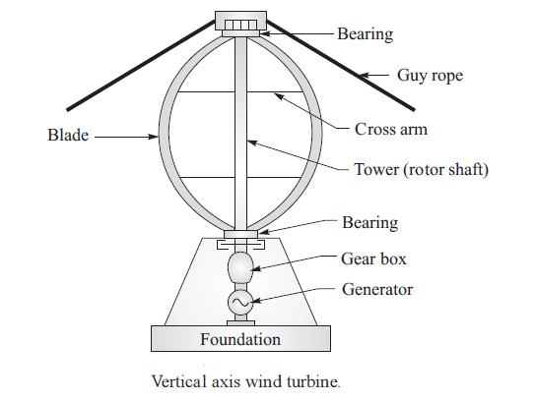
VAWT

Slide 29
VAWT
Vertical axis wind turbine has the axis of rotation of its rotor perpendicular to the wind stream. Vertical axis wind turbine is advantageous as (i) it can accept wind from any direction, thereby eliminating the necessity of any yaw control system and (ii) it can have its gearbox and generator system (nacelle) at the ground level, thereby eliminating the necessity of mounting the heavy nacelle (with gearbox and generator) at the top of the tower. These features of VAWT also help in the simpler design and installation of the wind turbine, the easier inspection and maintenance of the wind turbine and reducing the overall cost of the wind turbine.
A VAWT (Darrieus) with all its components is shown in Figure. The components and subsystems include tower blades and support structure.
Tower (rotor shaft)
The tower consists of a hollow vertical shaft which can rotate about its vertical axis between its bearings at top and bottom. It is provided with a support structure at the bottom and at the upper end, it is supported by guy ropes. The height of the tower is about l00 m.

Slide 30
VAWT
Blades
The wind turbine has two or three blades which are thin and curved shaped similar to an “eggbeater”. The blades are curved in such a way that minimum bending stresses are produced on rotation due to the centrifugal forces. The blades are designed in such a way that they offer aerofoil type cross section to wind stream. The height of blade is kept 94 m, diameter about 65 m and chord length about 2.4 m.
Support structure
It is provided with blades, gearbox and generator to support the weight of tower.

Slide 31
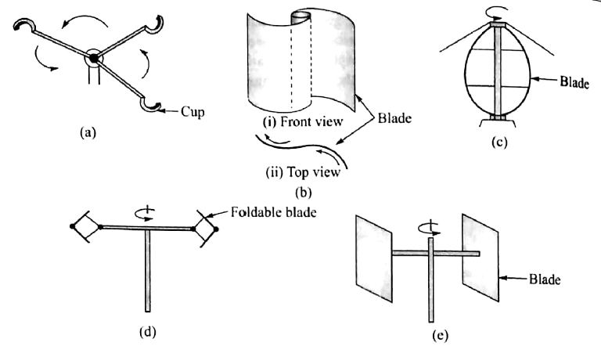
Rotors of VAWT

Slide 32
Rotors of VAWT
The VAWTs can have various types of rotors which include Cup type rotor, Savonious rotor, Darrieus rotor, Musgrove rotor and Evans rotor as shown in Figure. The simplest of all rotors is cup type rotor, which consists of three or four cup type structures attached symmetrically to a vertical shaft. It works on the principle that drag force on a large concave surface is more than that on a convex surface of the cup when wind stream strikes these surfaces, and so the rotor consisting of cups starts rotating. However, such rotors cannot extract enough energy from winds and therefore are not used for power generation. These devices are mainly used for wind speed measuring instruments such as the cup anemometer. The Savonius rotor (S-rotor) is formed with two half-cylinders attached to a vertical axis, but facing in opposite directions. S-rotor can produce high starting torque at low wind speed. It has also low efficiency of conversion of wind energy. As it can extract power even from low-speed winds, it can operate and deliver power throughout the day. Hence, such rotor is used for applications where low power is required, such as in wind pumping.

Slide 33
Darrieus rotor consists of two or three curved blades attached to a rotor shaft similar to an eggbeater. It has good power coefficient and is used for large power generation. It also has a large tip speed ratio, thereby developing large bending stresses in the blades due to centrifugal forces formed. The main drawback of this rotor is that it is not self-starting due to lower starting torque developed by it. It has to be run generally by using its electrical generator as motor. The blades also have fixed pitch which cannot be changed. This results in unmanageable output at high wind speeds. Musgrove (H-shaped) rotor has fixed pitch on blades attached to rotor shaft, but the blades are foldable to control power. The Evans rotor has blades which are hinged on a vertical rotor shaft and the blade pitch is varied cyclically during rotation to regulate the power output. It is a self-starting rotor.

Slide 34
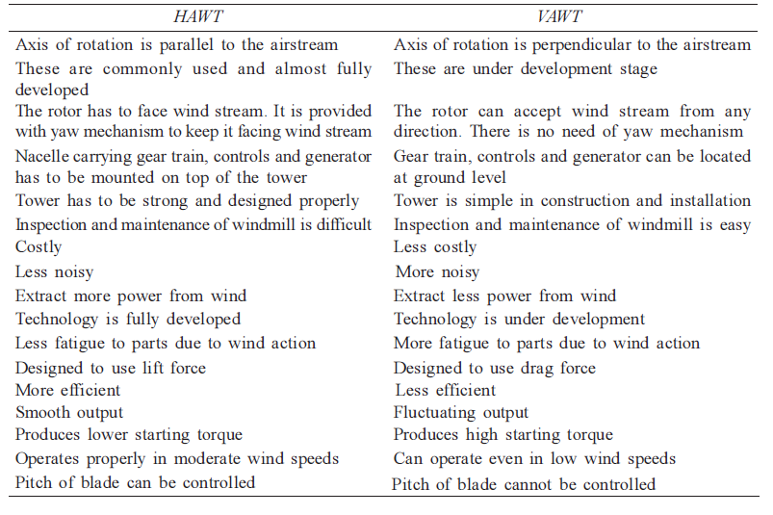
Comparison of HAWT & VAWT

Slide 35
Advantages
It is a renewable source
Like all forms of solar energy, wind power system are non-polluting, as it has no adverse influence on the environment
Wind energy systems avoid fuel provision and transport
On small scale upto a few Kilowatt system is less costly.

Slide 36
Disadvantages
Wind energy is available in dilute and fluctuating in nature
Unlike water energy wind energy needs storage capacity because of its irregularity
Wind energy systems are noisy in operation
Wind power systems have a relatively high overall weight.
Large areas are needed, propellors 1 to 3 m in diameter deliver power in the 30 to 300W range

Slide 37
Applications
Pumping applications
Direct heat applications
Electrical Generation applications

Slide 38
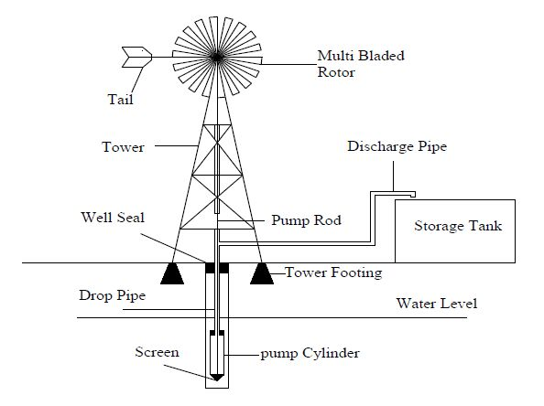
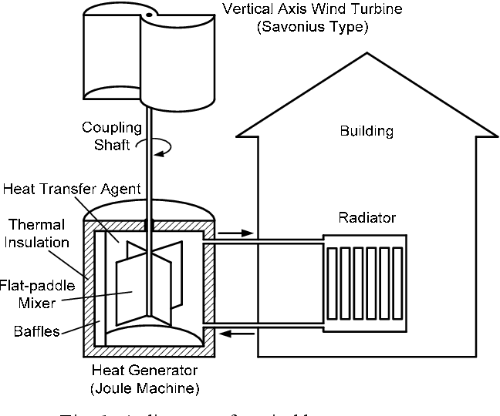
Pumping & Direct Heat Applications
Joule Machine

Slide 39
Thank You

